Slide 1

NabhyaantraX
Exploring the cosmos with the power of AI
Challenge: A World Away: Hunting for Exoplanets with AI
Hackathon: NASA Space Apps Challenge
Team: Below Average

Slide 2

IDEA TITLE
Key Problems We Are Addressing
Manual exoplanet classification is slow & error-prone
Large volumes of NASA mission data remain underutilized
Lack of accessible tools for researchers & space enthusiasts
Our Solution
NabhyaantraX: An AI-powered exoplanet detection platform
Classifies celestial bodies as Confirmed, Candidate, or False Positive
Supports manual input & bulk CSV uploads
Interactive chatbot for exoplanet & space Q&A
Our Vision
Democratize exoplanet discovery through AI
Build a platform where science meets accessibility
Inspire curiosity & learning about worlds beyond our own
Innovation & Uniqueness
Combines AI classification + visualization + conversational learning
Model explainability with feature importance & metrics
Integration-ready with NASA APIs for live exoplanet data
Designed for both researchers & students, bridging science & education

Slide 3







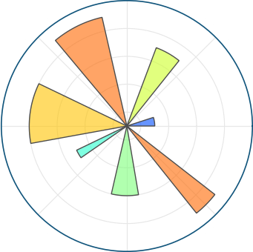







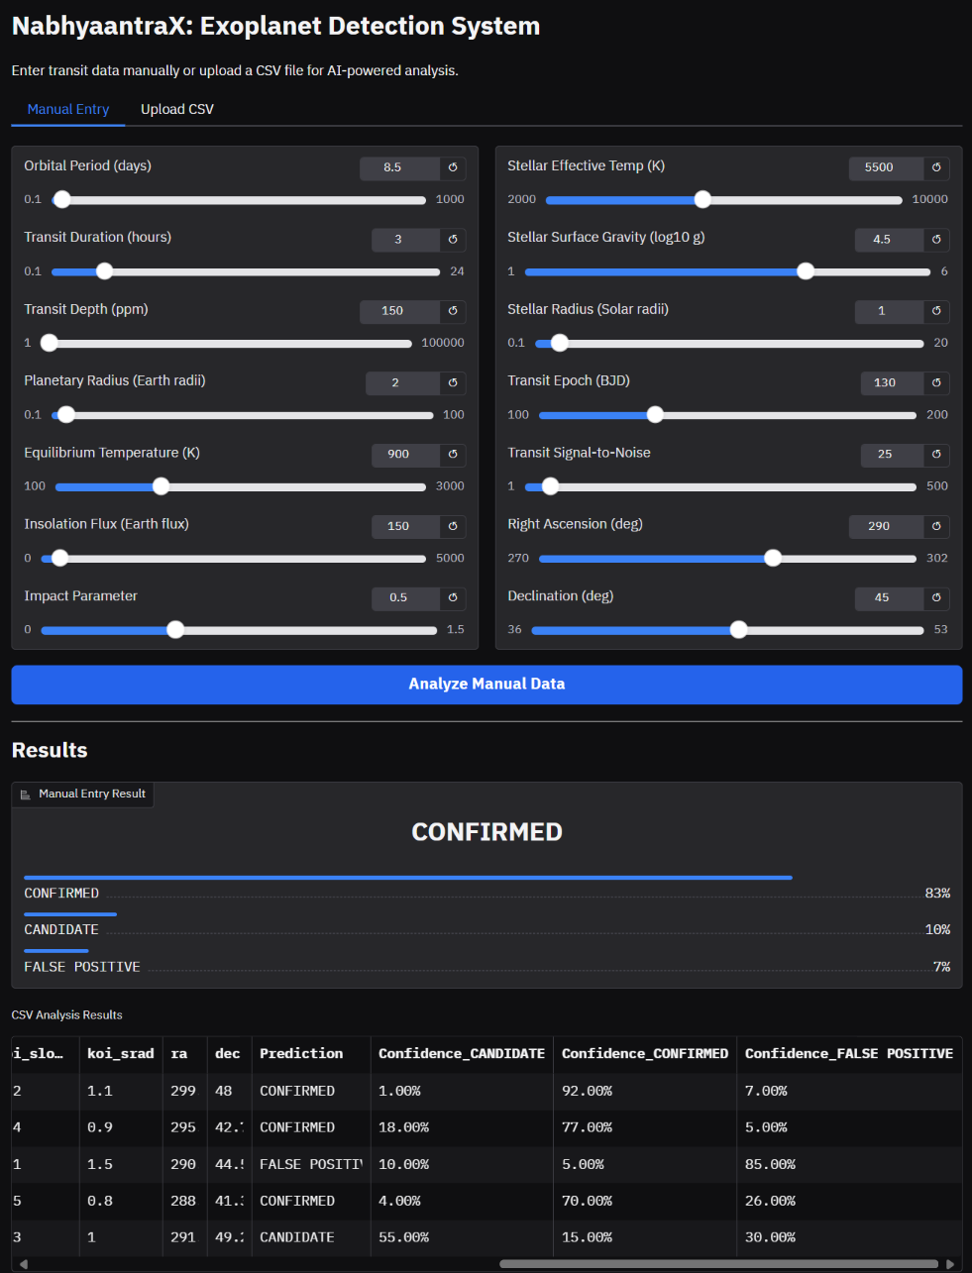
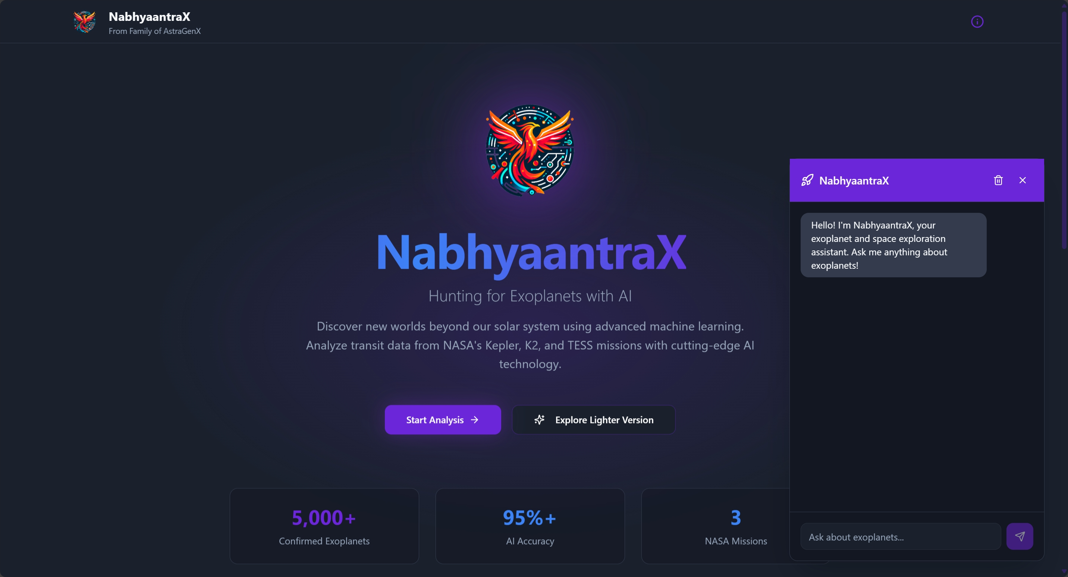
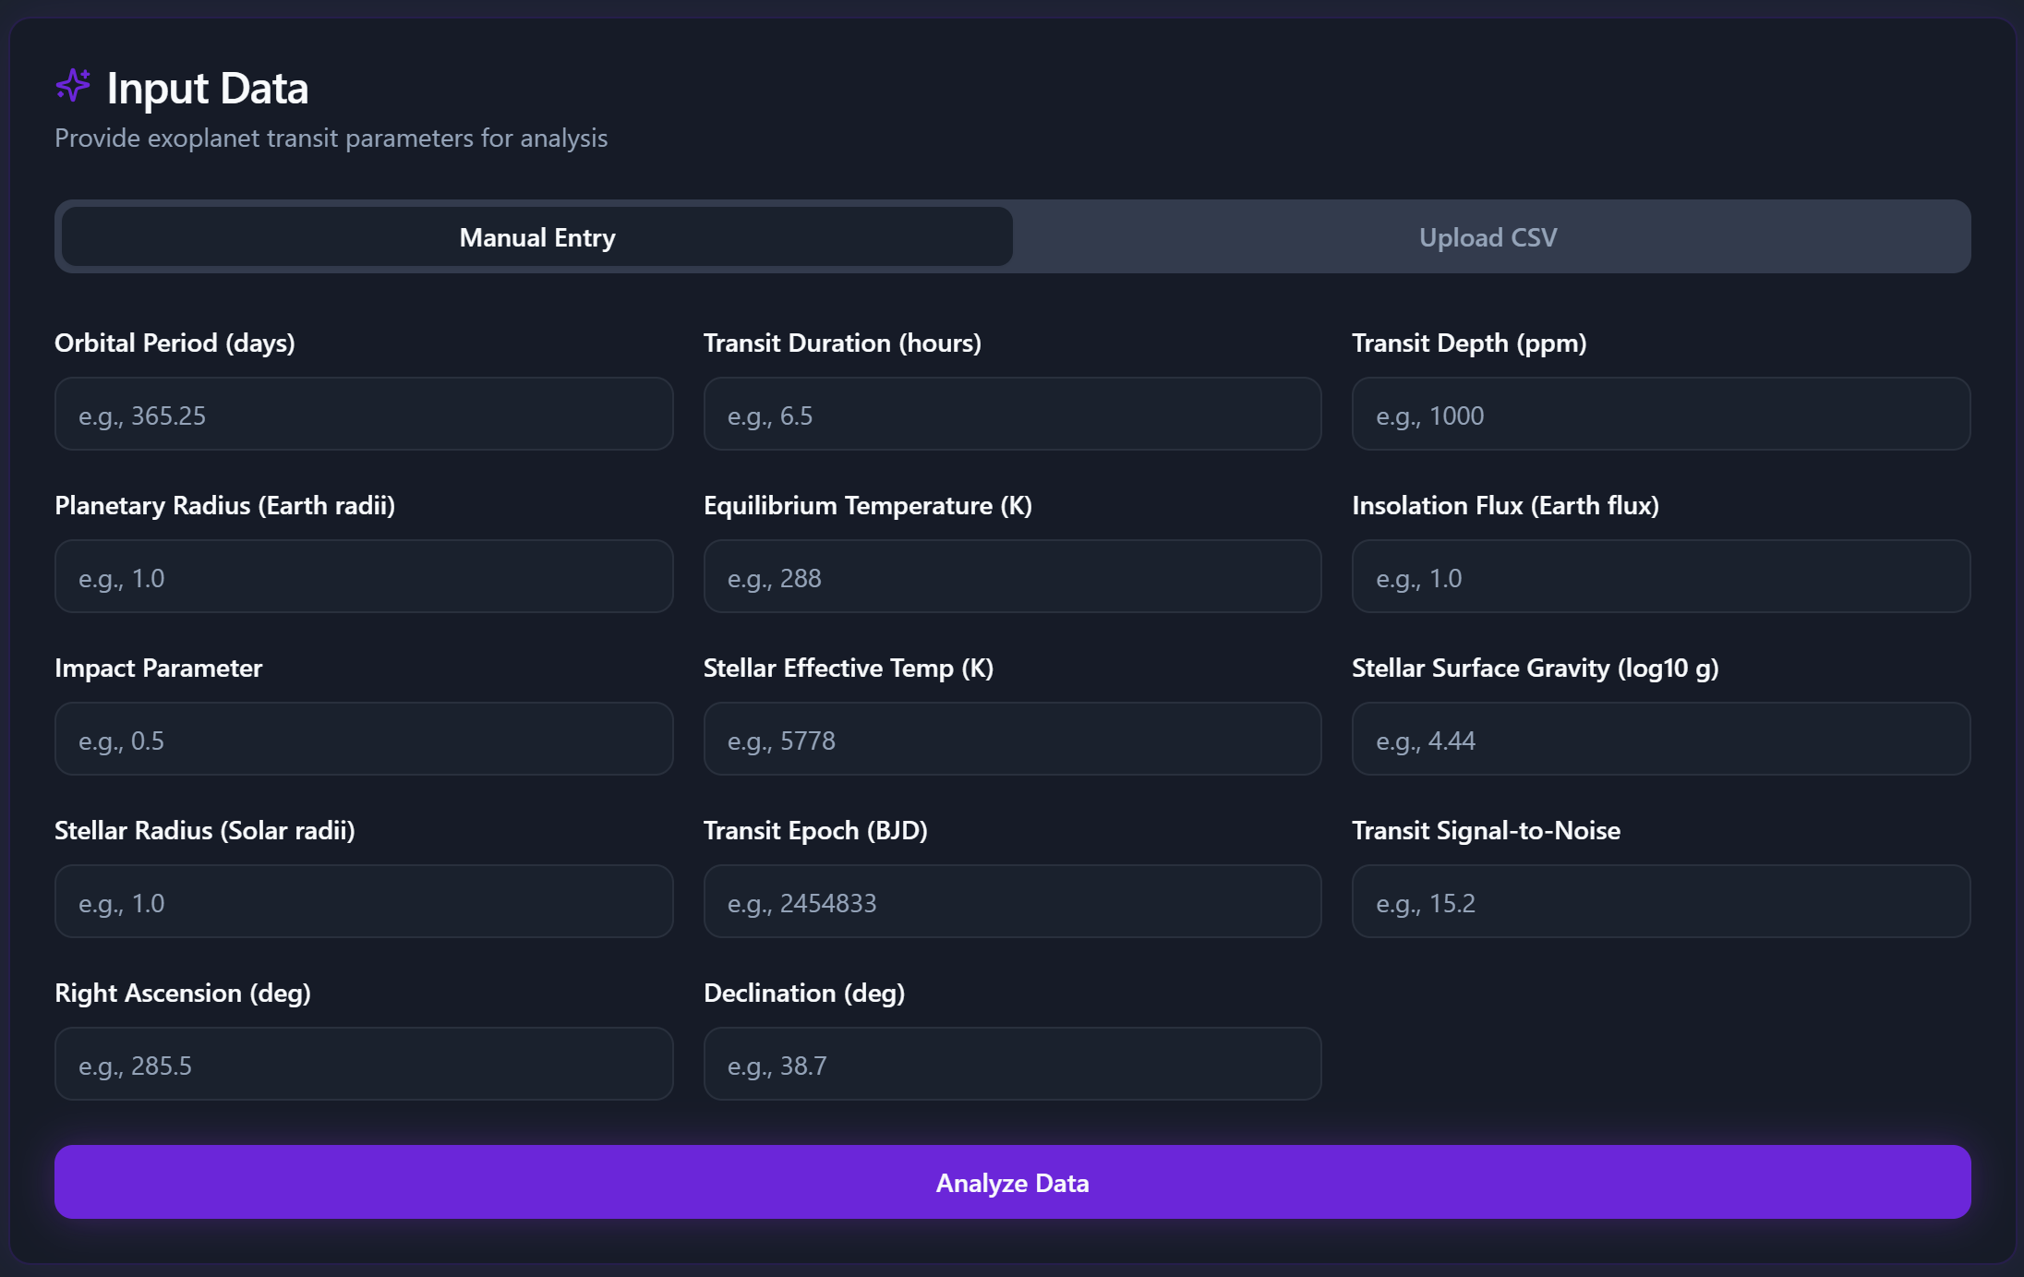
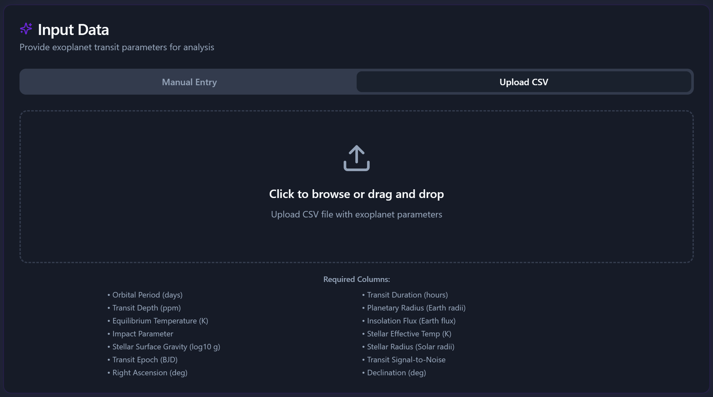
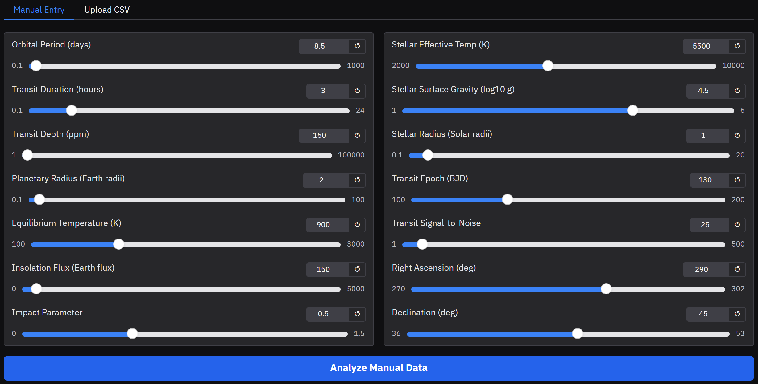
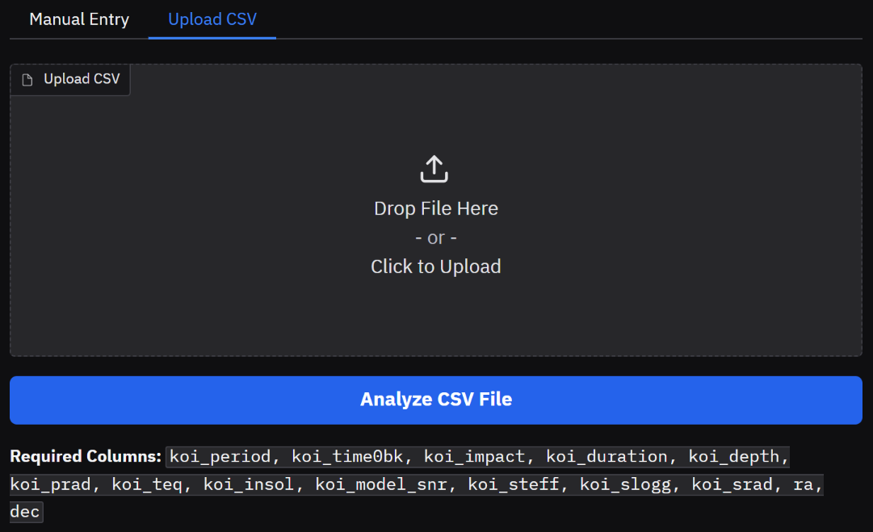
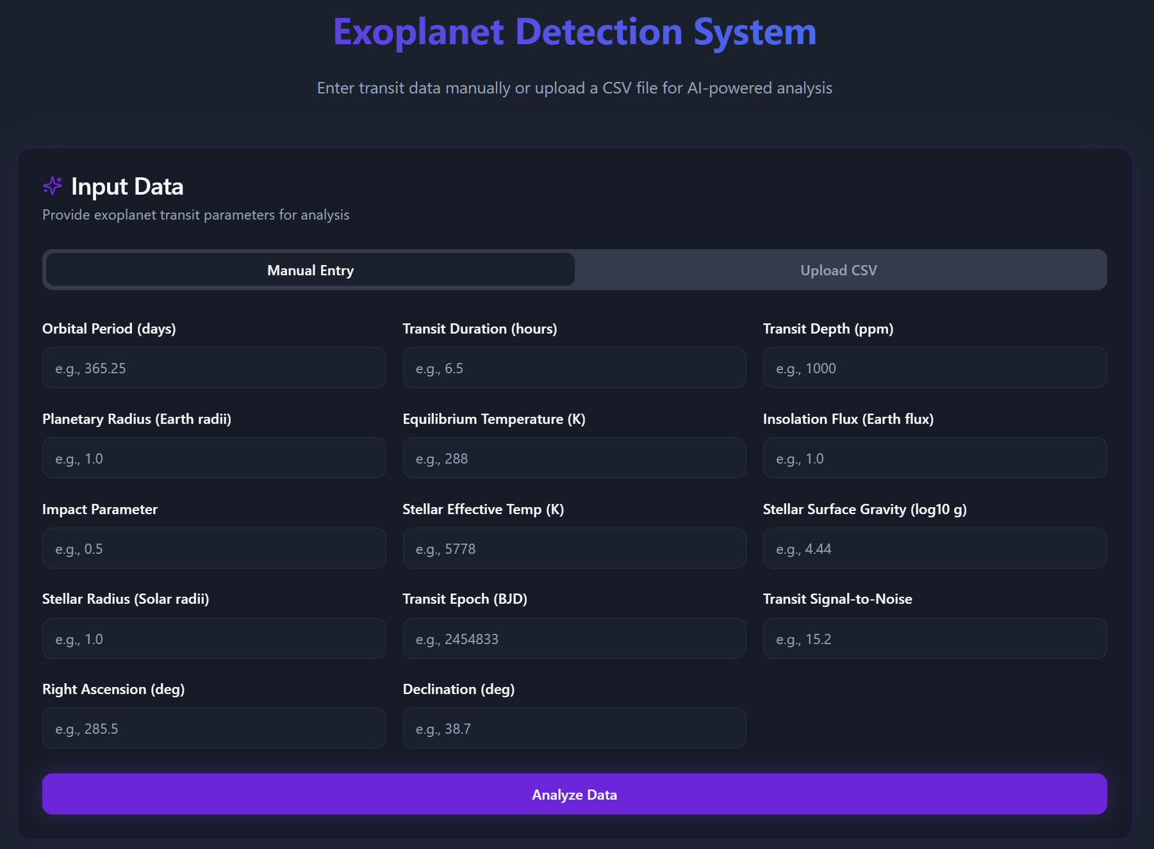
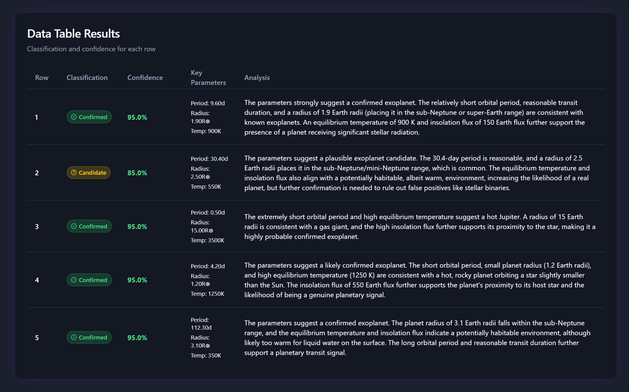
TECHNICAL APPROACH
Stakeholders
Tech Stack
Astronomers & Researchers – Need faster, accurate classification
Students & Enthusiasts – Want interactive, educational tools
NASA & Space Agencies – Benefit from AI-driven automation in discovery
Prototype
Workflow
Phase 1: Working ML model hosted on HuggingFace (Gradio UI)
Phase 2 (Final): Advanced model + React.JS/TypeScript UI + Chatbot
Input options: Manual data entry / Bulk CSV upload
Step 1: Data Collection Gather open-source NASA datasets (Kepler, TESS, Exoplanet Archive).
Step 2: Data Preprocessing Clean, normalize, and engineer features (orbital period, transit depth, etc.).
Step 3: Model Training Train ML model on labeled data (Confirmed, Candidate, False Positive).
Step 4: Prediction Engine Model analyzes new/manual/CSV input and classifies exoplanets.
Step 5: Visualization & Explainability Display results with charts, metrics, and feature importance.
Step 6: User Interface React + TypeScript UI for input, results, and chatbot interaction.
Output: Confirmed, Candidate False Positive with explanations & visualizations
Step 7: Deployment & Hosting Deploy model on HuggingFace / Render and UI on Vercel for global access.
Live Link: NabhyaantraX

Slide 4
FEASIBILITY AND VIABILITY
Challenges & Risks
Strategies to Overcome
Viability
Technical Feasibility
Uses publicly available NASA datasets
First Prototype already functional on HuggingFace and the final one in Netlify
Lightweight ML models ensure smooth deployment
Handling noisy/imbalanced data
Ensuring model explainability & trust
Free hosting limits (compute/storage)
Apply preprocessing & feature selection to reduce noise
Use XAI tools (SHAP, feature importance) for transparency
Deploy hybrid model (HuggingFace + Netlify + Vercel) to remain cost-free
Scalable to larger datasets & future NASA missions
Open-source → accessible to global community
Supports both researchers & learners → wide adoption potential

Slide 5
IMPACT AND BENEFITS
Speeds up exoplanet discovery with AI automation
Reduces manual errors in classification
Provides explainable results for researchers
Engages students & enthusiasts through interactive UI and chatbot
Makes exoplanet science more accessible worldwide
Inspires next-gen learners to explore space + AI
Cost-effective, open-source, and free-to-use platform
Promotes global collaboration in space science
Encourages cross-disciplinary innovation (CS + Astronomy)
Scientific Impact
Educational Impact
Cloud-based solution → minimal resource footprint
Reduces need for large-scale on-premise infrastructure
Social & Economic Benefits
Environmental Benefits

Slide 6
RESEARCH AND REFERENCES
NASA Data & Resources
Kepler Objects of Interest (KOI): Confirmed exoplanets, candidates, false positives (classification via Disposition Using Kepler Data).
TESS Objects of Interest (TOI): Confirmed planets, PCs, FPs, APCs, KPs (classification via TFOPWG Disposition).
K2 Planets & Candidates: Confirmed exoplanets, candidates, false positives (classification via Archive Disposition).
Research Articles
Exoplanet Detection Using Machine Learning: Overview of ML approaches for classification (2021).
Assessment of Ensemble-Based ML Algorithms for Exoplanet Identification: High-accuracy techniques & preprocessing strategies.
Space Agency Partner Resources
CSA – NEOSSat Data: Astronomical images for asteroids, debris, satellites, exoplanets.
NEOSSat Program: Canada’s contributions to asteroid/debris tracking & exoplanet detection.
James Webb Space Telescope (JWST): Advanced exoplanet detection & Canada’s role in mission.
Additional Links
NASA Exoplanet Archive: https://exoplanetarchive.ipac.caltech.edu/
Exoplanet Exploration Program: https://science.nasa.gov/exoplanets
NASA Space Apps Challenge: https://www.spaceappschallenge.org/

